Slide 1














CGM
Conqueror Gamer Management
Notes:
https://unsplash.com/photos/AXu2aZ3YgP8

Slide 2

About CGM

Slide 3



About CGM
CGM - Conqueror Gamer Management by using an Artificial Intelligence
Student - Vinod Sahan Nawarathna
UOB number - 2136690
Supervisor - Dr. Yasas Jayaweera
BSc (Hons) Computer Science and Software Engineering

Slide 4

Introduction

Slide 5


Introduction
What are the project's artefacts and what is the project's broad summary?
What is the history of the project and why was it started?
What does video game addiction mean in terms of a problem?
What is the project's scope and how was it accomplished?
What is the project's conclusion, and how does it intend to deal with the problem of video game addiction?
Notes:
https://unsplash.com/photos/fItRJ7AHak8

Slide 6

Aim and Objectives

Slide 7


Aim and Objectives
Aim
To develop the Conqueror Gamer Management (CGM) application to help gamers manage their time and prevent video game addiction.
Objectives
Design AI app for healthy gaming habits.
Develop default time packages for balance.
Assist in implementing packages and taking breaks.
Create complete addiction treatment with tools and optimization.
Improve well-being, productivity, and relationships while reducing risks.
Contribute to conversation on tech's role in positive gaming behavior.
Notes:
https://unsplash.com/photos/48nerZQCHgo

Slide 8

Literature Review

Slide 9



Literature Review
Current discussion and research on computer gaming addiction
Comparable applications for managing video game addiction
Major issues in gaming apps and services
Computer-related health problems associated with excessive gaming
The importance of time management in life
Technologies used in the project, including Artificial Intelligence (AI), Machine Learning, and Data Analysis Techniques.
Notes:
https://unsplash.com/photos/TvN54bnuQg8

Slide 10

Methodology

Slide 11



Methodology
What is the methodology used ?
Why the Researcher Choose this methodology?
6 Phases of the Methodology
Feasibility Study
Requirement Analysis
Design
Coding and Unit Testing
Integration and System Testing
Maintenance
Notes:
https://unsplash.com/photos/GKLIsLZxhj0

Slide 12

Timeline

Slide 13


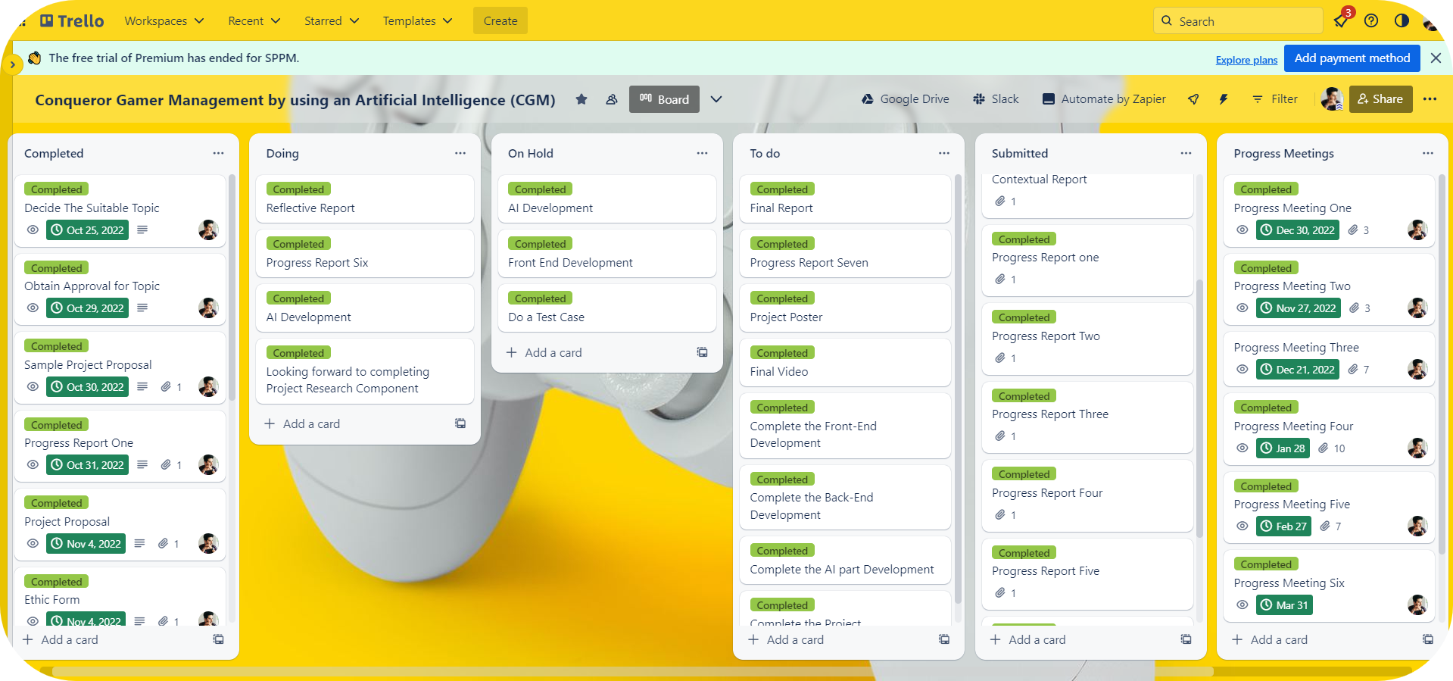
Timeline
Notes:
https://unsplash.com/photos/GKLIsLZxhj0

Slide 14

Key Features

Slide 15



Key Features
Ordinary Key Features
Capture and filter Screen Shots.
Screen recording.
Gamer achievements page.
Hardware Monitoring.
FPS Counter.
Extreme Key Features
Develop time management packages.
Enable Gaming Mode (Power plan).
Notes:
https://unsplash.com/photos/GKLIsLZxhj0

Slide 16

Technologies

Slide 17
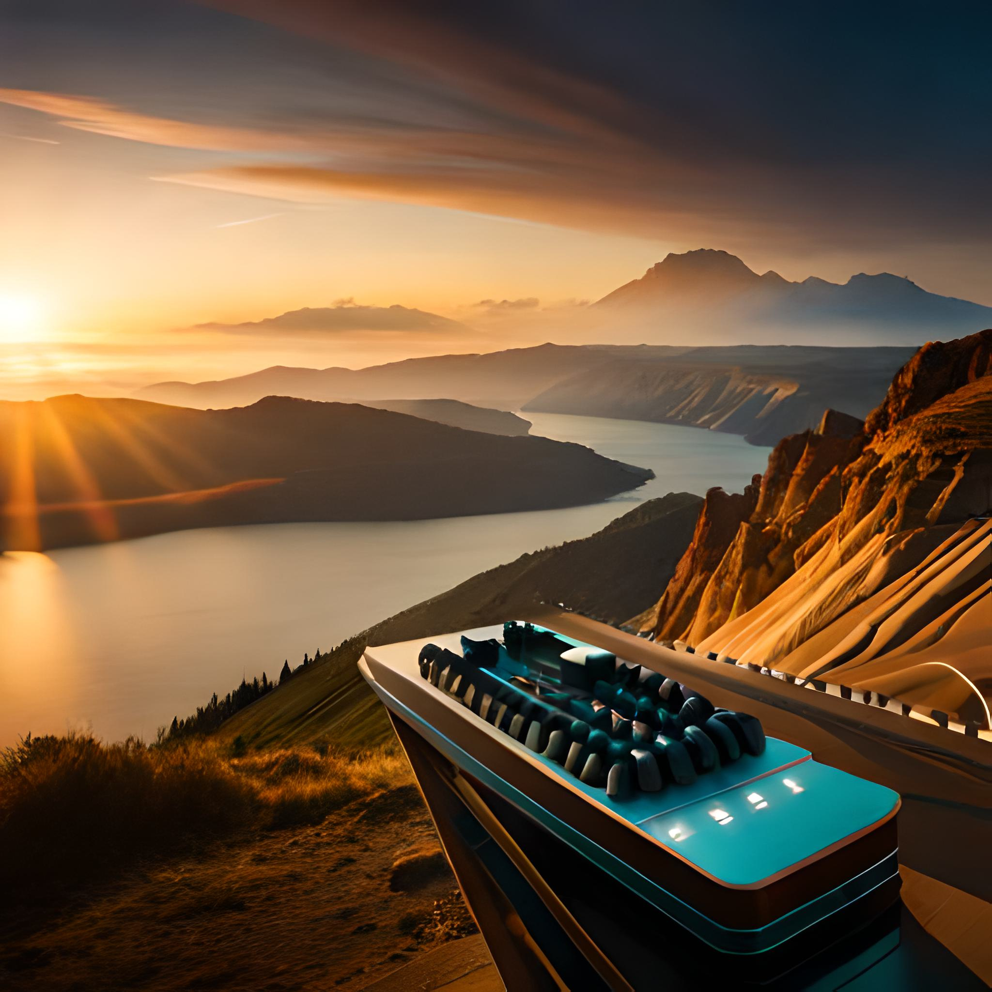
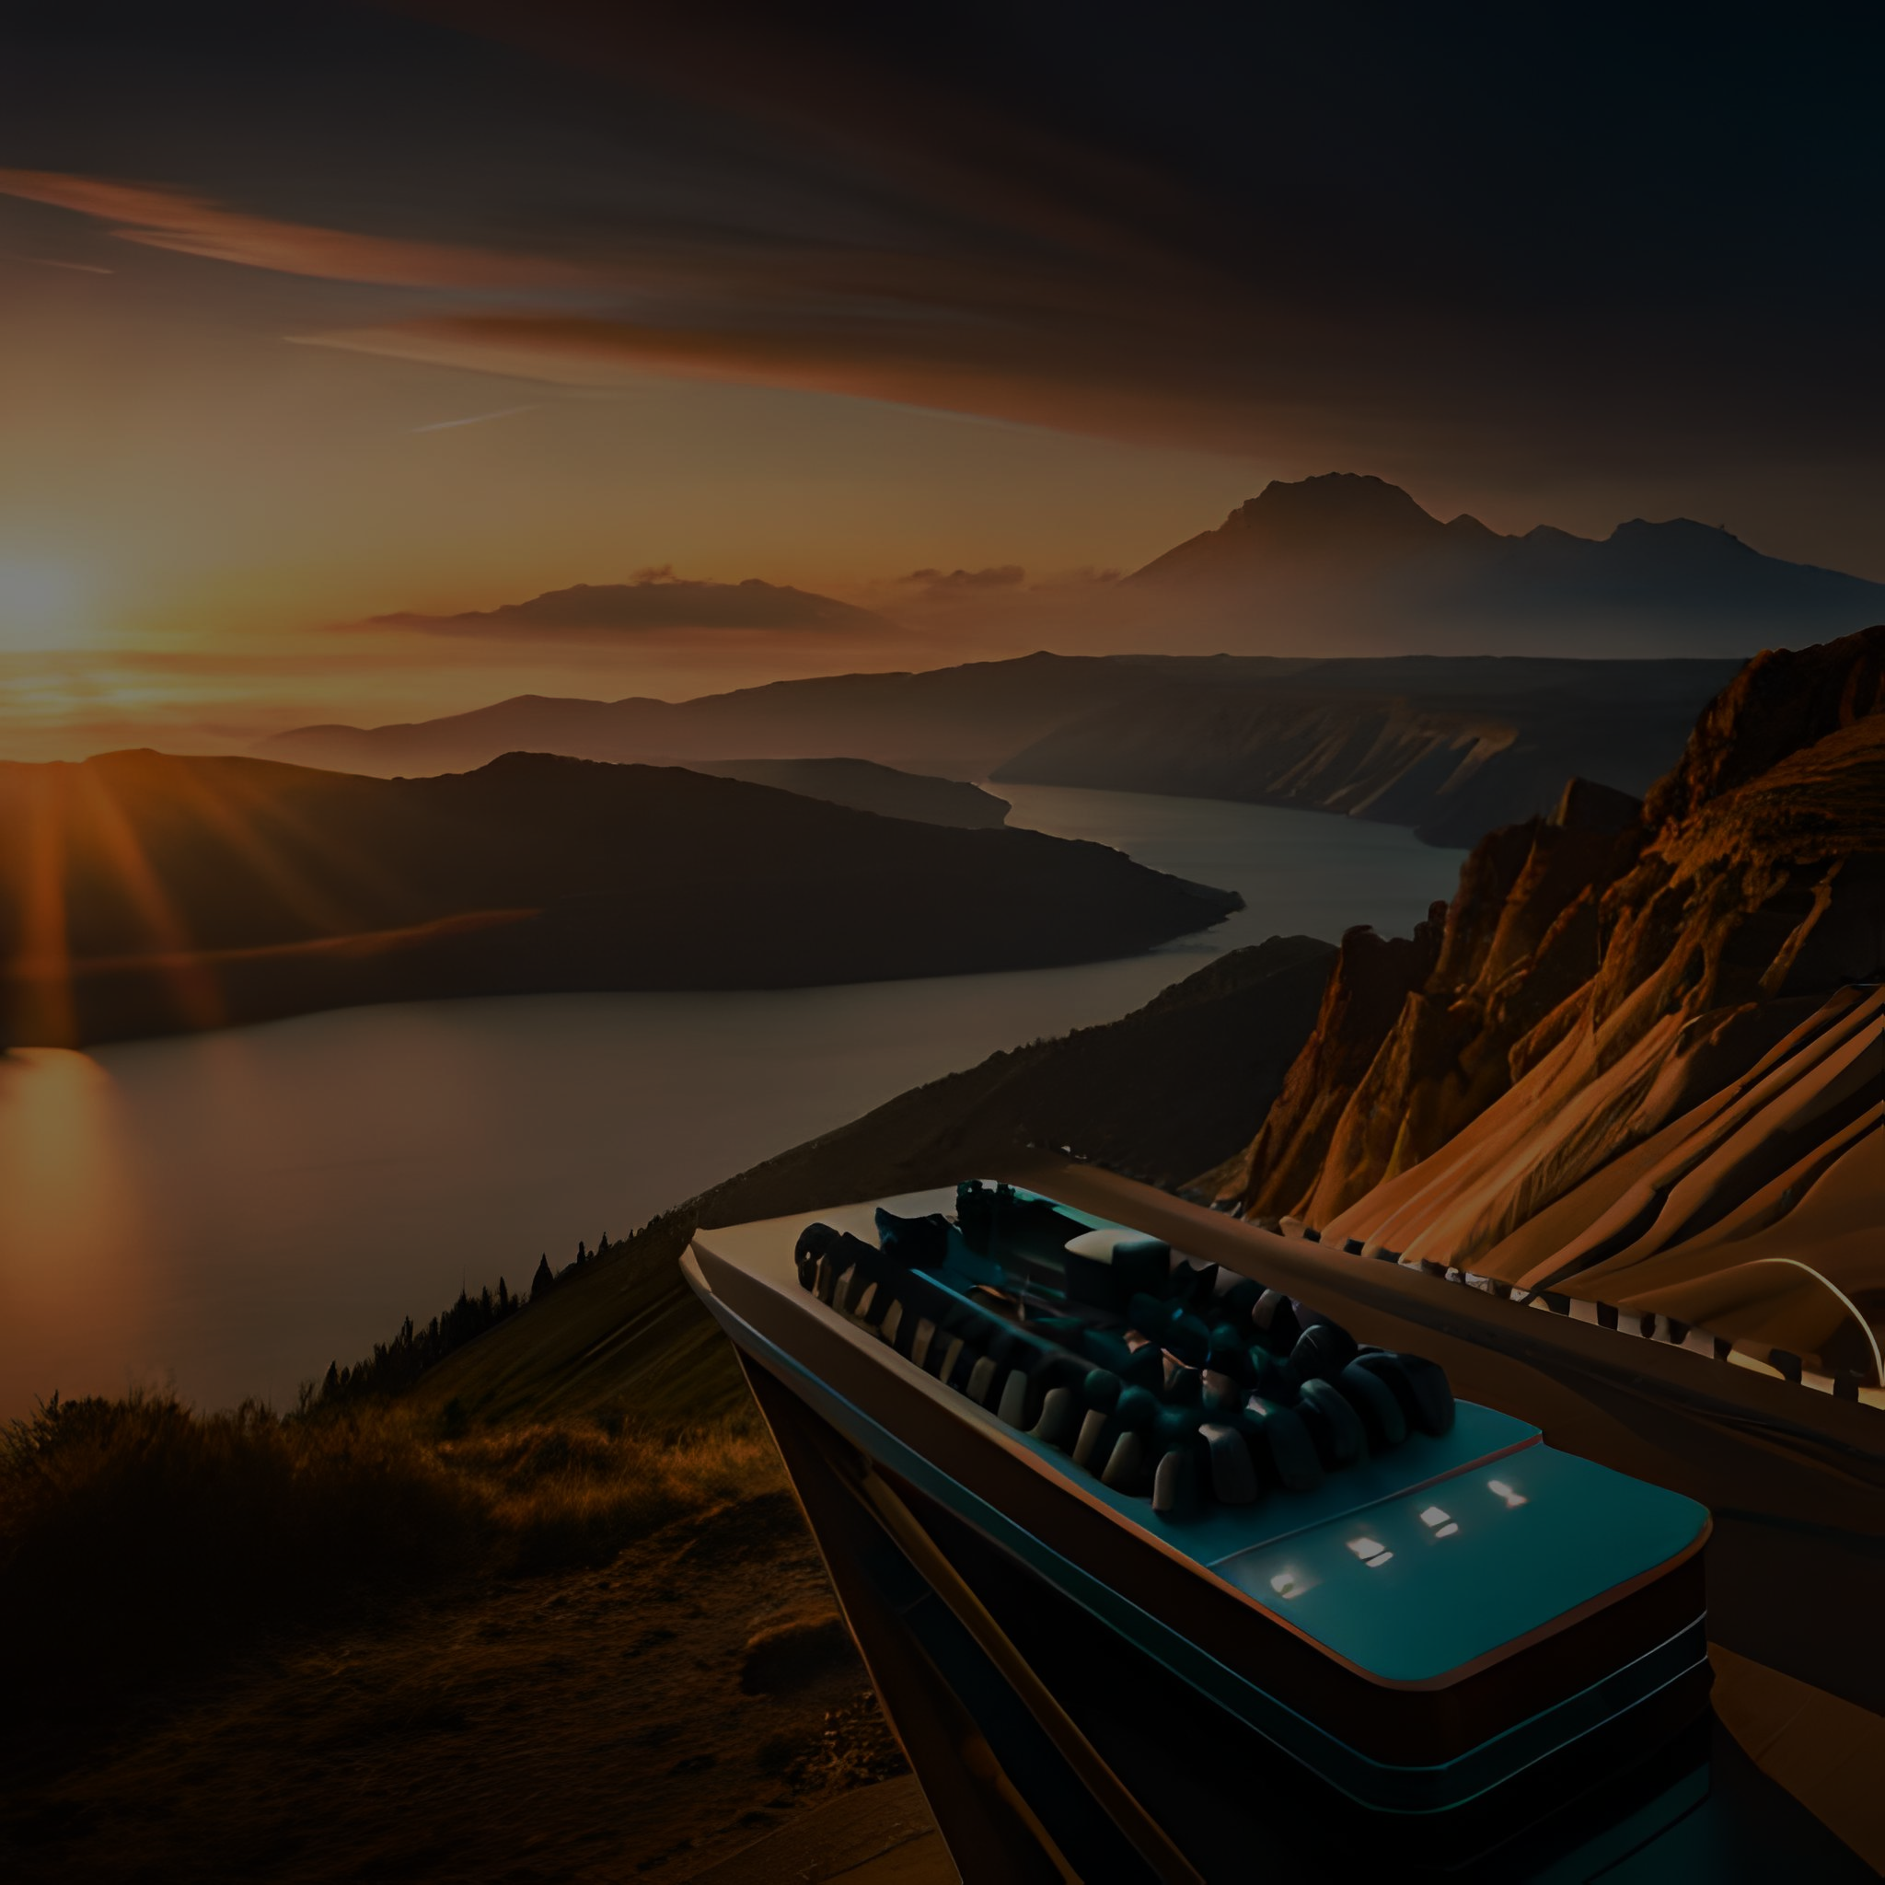












Technologies
Notes:
https://unsplash.com/photos/GKLIsLZxhj0

Slide 18

Demonstration

Slide 19


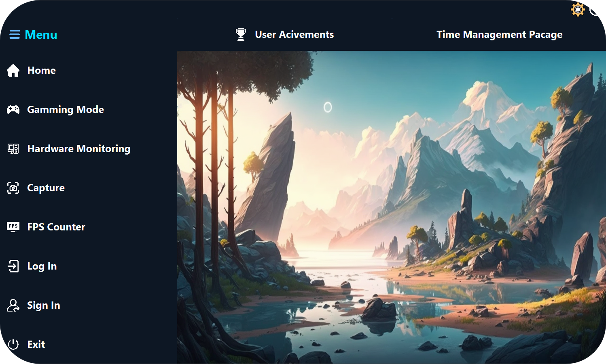
Demonstration
Notes:
https://unsplash.com/photos/GKLIsLZxhj0

Slide 20

Testing

Slide 21



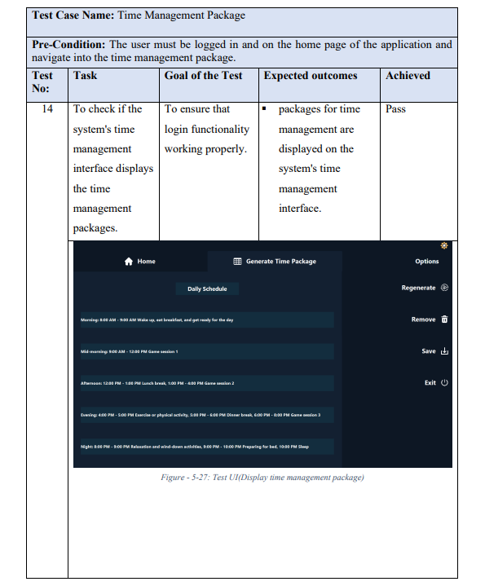
Testing
Testing Snapshot of Time Management Package
Notes:
https://unsplash.com/photos/GKLIsLZxhj0

Slide 22

Evaluation

Slide 23


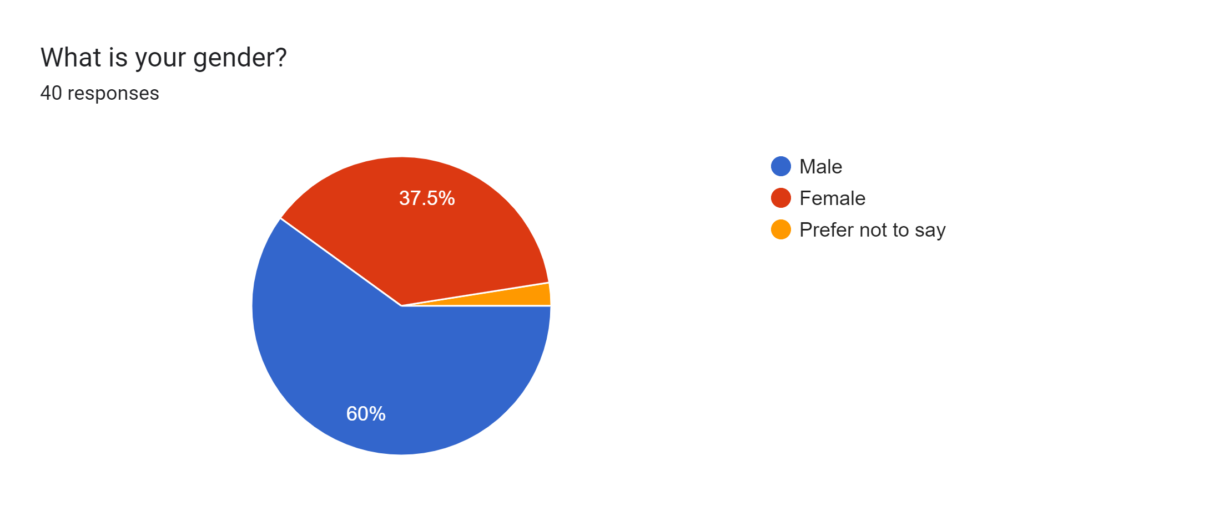
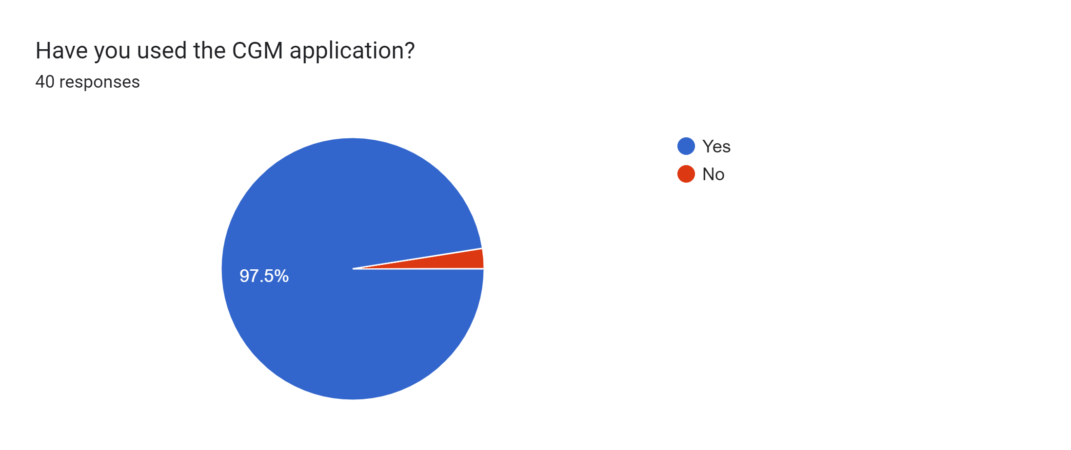
Evaluation
Questionnaire
What is your gender?
Questionnaire
Have you used the CGM application?
Notes:
https://unsplash.com/photos/GKLIsLZxhj0

Slide 24

Limitations

Slide 25







Available only in English
Limitations
Only available in operating system platforms
Limitations of visual filtering
User compliance
Limitations of visual filtering
Notes:
https://unsplash.com/photos/GKLIsLZxhj0

Slide 26

Future Works

Slide 27


Future Works
Tools for Personalised Time Management.
Social Tools.
Expansion to other platforms.
Continuous research and development.
Notes:
https://unsplash.com/photos/GKLIsLZxhj0

Slide 28


Thank You

